Slide 1
Secure Data Hiding in Image Using Steganography
CAPSTONE PROJECT
Presented By:
Student Name : FAKRUDDIN
College Name & Department : Department Of Computer Science And Application, Reva University, Bengaluru

Slide 2
OUTLINE
Problem Statement
Technology used
Wow factor
End users
Result
Conclusion
Git-hub Link
Future scope

Slide 3
Problem Statement
In today's digital world, securing confidential information is crucial. Traditional encryption methods can raise suspicion, making them vulnerable to attacks. Image Steganography provides a covert way of hiding secret messages within images, ensuring secure communication without drawing attention. This project aims to build a user-friendly web application that allows users to encrypt and decrypt messages using images.

Slide 4
Technology used
Programming Language:
Python – Backend logic and image processing
Backend Framework:
Flask – Lightweight web framework for handling requests
Frontend Technologies:
HTML, CSS (Bootstrap) – Responsive web UI
Libraries Used:
OpenCV – Image processing for encryption & decryption
NumPy – Efficient array manipulation
Tkinter – GUI for standalone script execution (optional)
Platforms & Tools:
Git & GitHub – Version control & collaboration
Jinja2 – Template engine for Flask
Heroku / Render / Localhost – Deployment options

Slide 5
Wow factors
What makes this Image Steganography Web App stand out from other projects?
1. ✅ Web-Based & User-Friendly UI
- Unlike many steganography tools that rely on command-line execution, this project offers an intuitive web interface built with Flask, making it easy for anyone to use.
2. 🔒 Passcode-Protected Encryption
- The hidden message is secured with a passcode, ensuring that only authorized users can decrypt and read the message.
3. 🖼️ Minimal Image Distortion
- Many steganography methods visibly alter the image, making it easy to detect.
- This project minimizes pixel modifications, ensuring the hidden message remains undetectable to the human eye.
4. 📡 Secure Data Transmission
- Messages remain covertly hidden inside images, avoiding suspicion.
- No separate encryption files—only the modified image is shared.
5. 💻 Cross-Platform Compatibility
- Works seamlessly on Windows, Linux, and macOS without requiring complex installations.
6. ⚡ Lightweight & Fast Processing
- Unlike traditional steganography tools that require heavy computational resources, this app ensures:
- Fast encryption & decryption
- Small file sizes with efficient encoding

Slide 6
End users
Journalists & Whistleblowers – Securely send sensitive information.
Government Agencies – Covert communication for intelligence purposes.
Cybersecurity Enthusiasts – Learn about cryptographic security.
General Users – Hide personal messages securely.

Slide 7
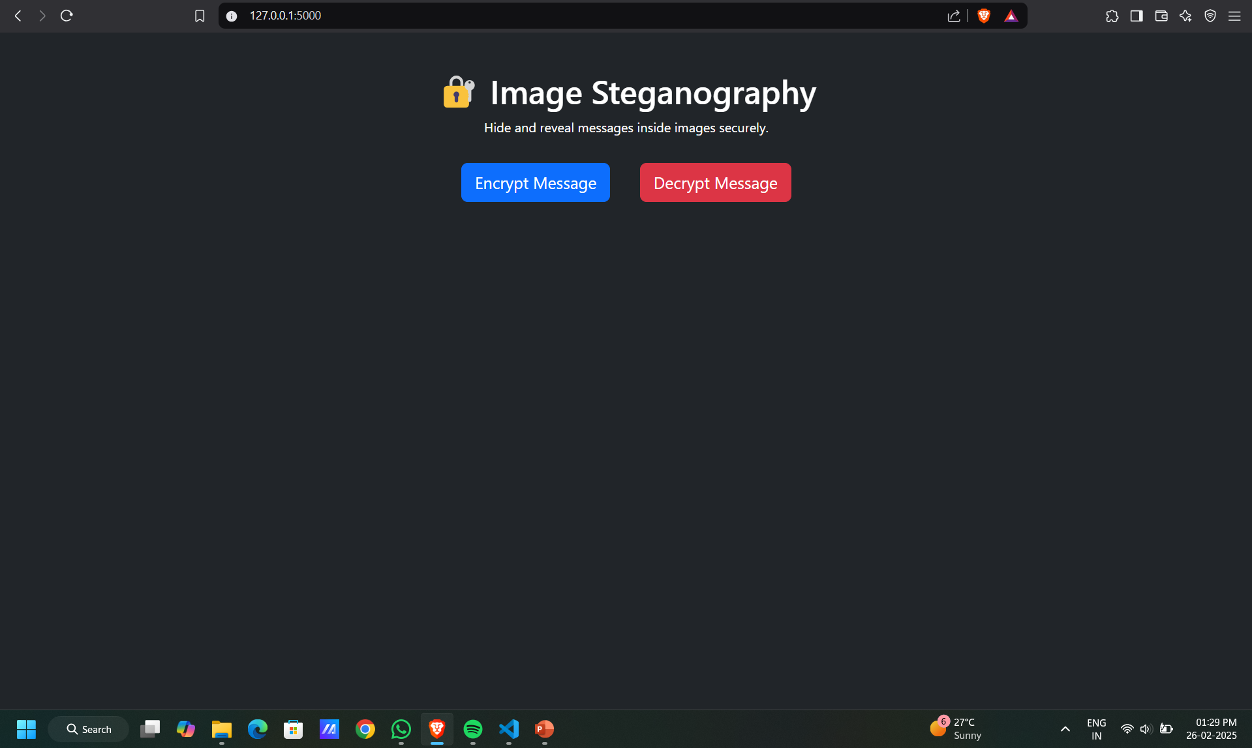
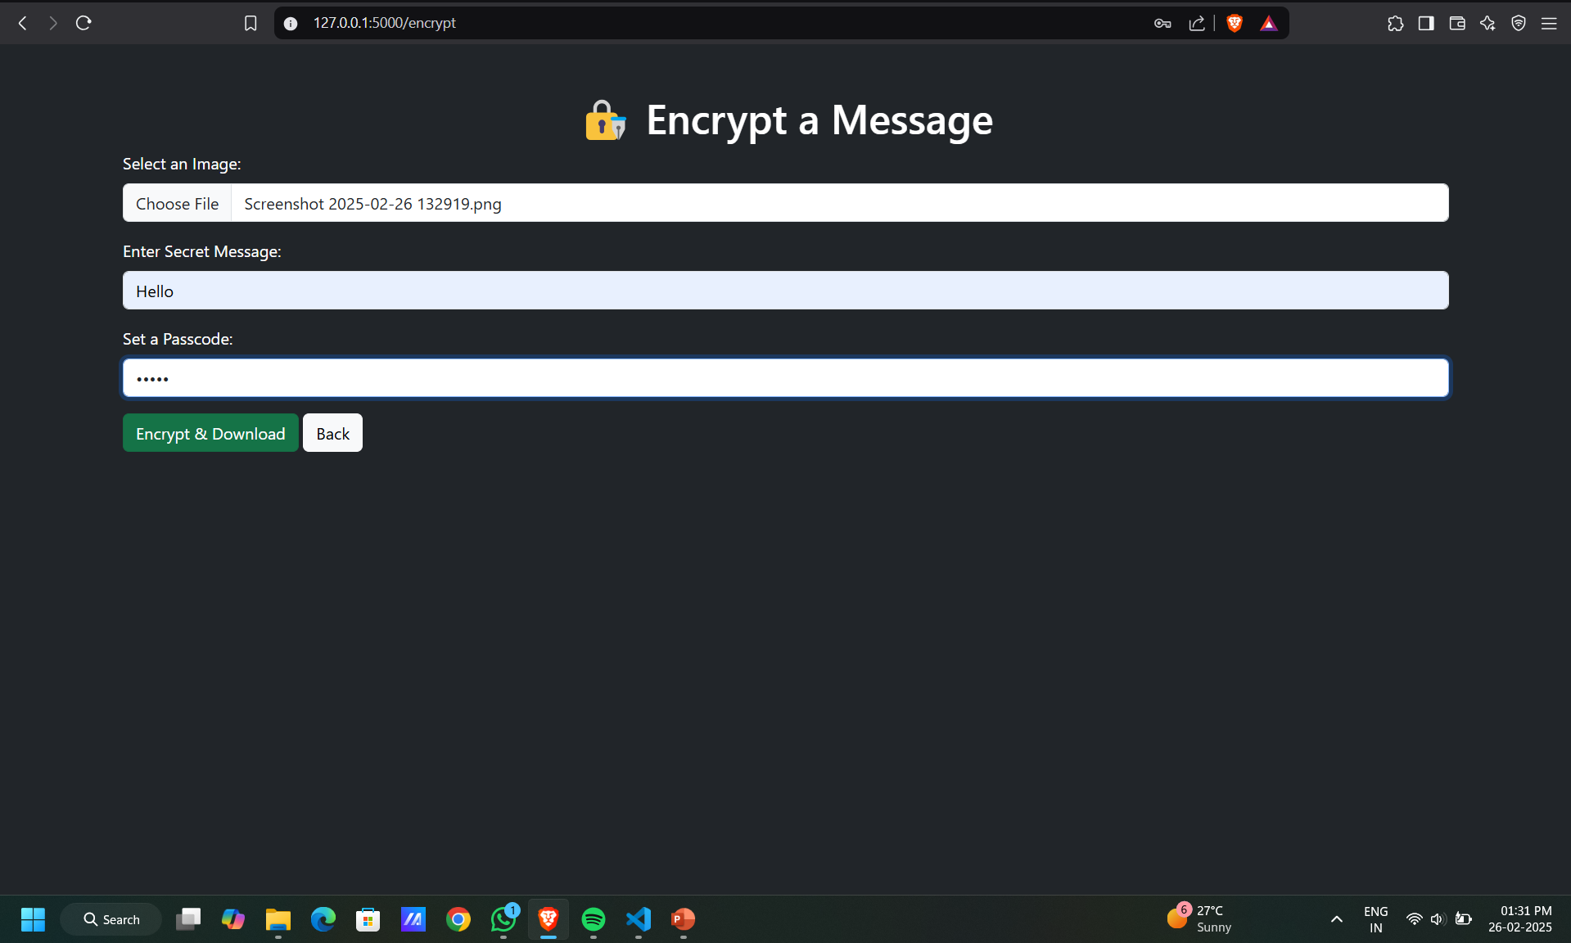
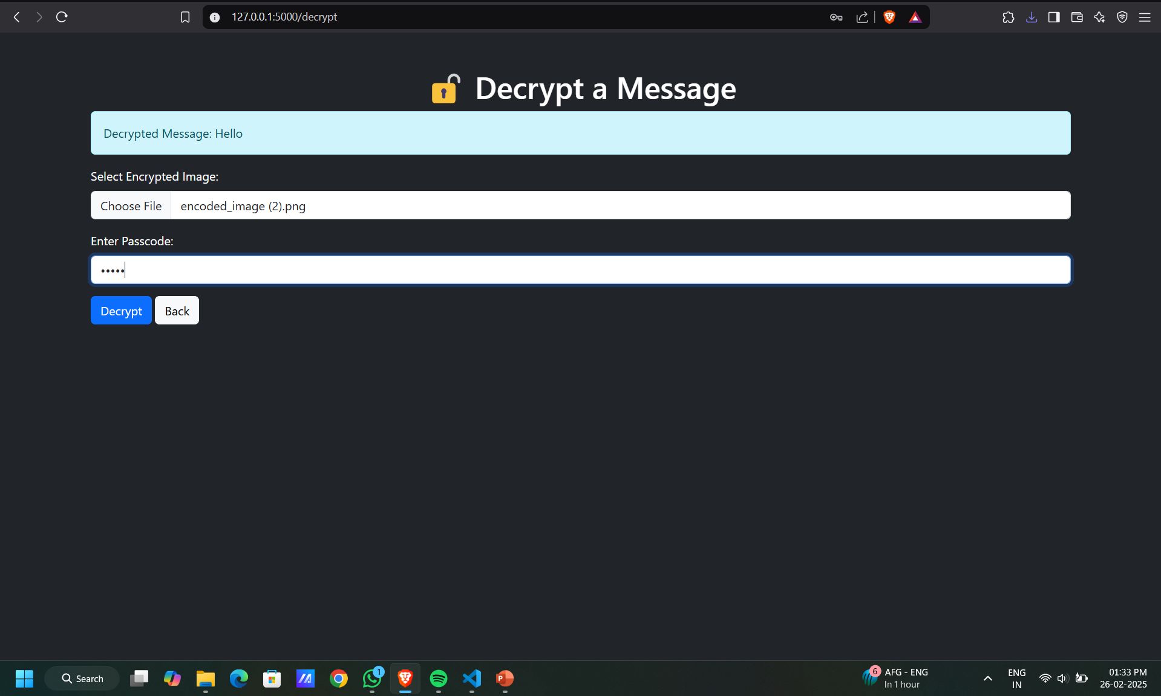
Results
Demo Link
🔗 View File on Google Drive

Slide 8
Conclusion
This Image Steganography Web App successfully addresses the problem of secure message transmission by embedding hidden messages inside images without noticeable changes. Unlike traditional encryption methods, which may attract attention, steganography allows covert communication, making it ideal for data privacy, cybersecurity, and secure digital messaging.
Through the use of Flask, OpenCV, and a passcode-protected mechanism, this project ensures that only authorized users can access the hidden data. The web-based interface makes it user-friendly, eliminating the need for complex command-line tools.
In conclusion, this project provides a lightweight, secure, and efficient solution for concealed data transmission, offering potential future enhancements such as AI-based image security, mobile app integration, and cloud-based encryption. This ensures a scalable, real-world application in the field of cybersecurity and secure communication.

Slide 9
GitHub Link
🔗 Image Steganography Web App

Slide 10
Future scope
AI-based Image Analysis – Detecting steganographic modifications.
Multiple Image Formats Support – Support for BMP, GIF, etc.
Mobile App Version – Extending functionality to Android & iOS.
Cloud Integration – Secure storage & retrieval of encrypted images.
Blockchain Security – Using decentralized networks for secure message transfers.

Slide 11
THANK YOU

